Slide 1


CLAUDE CODE MASTERCLASS

Slide 2
BUILDING APPS WITH CLAUDE CODE

Slide 3
CLAUDE.MD

Slide 4

CLAUDE.md
CLAUDE.md is a markdown file you add to your project root that Claude Code reads at the start of every session.
Claude thinks of it as a permanent briefing note; Claude shows up knowing your project without you repeating yourself every time.
CLAUDE.md
# AI Finance Agent — Project Context
## What This Is
A Python-based AI agent that analyzes financial statements and generate reports.
## Tech Stack
- Python 3.11, pandas, yfinance, matplotlib
- Anthropic Claude API (claude-sonnet-4-6) & Jupyter Notebooks for prototyping
## Key Commands
```bash
# Run the agent
python agent.py
# Run tests
pytest tests/ -v
# Install dependencies
pip install -r requirements.txt --break-system-packages
# Launch notebook
jupyter notebook notebooks/
```
## Project Structure
- /agent.py — Main agent entry point
- /tools/ — Financial analysis tools (ratio calc, etc.)
- /data/ — Sample 10-K filings (do not modify)
- /notebooks/ — Exploratory analysis (not production code)
- /tests/ — Unit tests
## Code Style
- Use type hints on all functions
- Docstrings required for every function
- Variable names should match finance terminology (e.g., `current_ratio`, not `cr`)
## Domain Terms
- **Liquidity Risk**: Risk that a firm can't meet short-term obligations
- **Current Ratio**: current_assets / current_liabilities
- **10-K**: Annual SEC filing — source of truth for financial data
## Workflow for New Features
1. Write a plan and confirm with user before coding
2. Write tests first (Test Driven Development (TDD))
3. Implement the feature
4. Run pytest and confirm passing
5. Update this CLAUDE.md if new patterns emerge
## Do Not Touch
- /data/raw/ — original source files, never modify
- .env — API keys, never log or print these
© All rights reserved for Dr. Ryan Ahmed @Stemplicity Inc.

Slide 5
CLAUDE.md Best Practices
Think of CLAUDE.md as AI onboarding, not a wiki. High signal, short, and stable.
DO
DON'T
Keep it under 200 lines
Include your key commands (run, test)
Add domain-specific terms your project uses
Define your preferred workflow steps
Update CLAUDE.md when new patterns emerge
Dump everything you know about the project
Write instructions that only apply sometimes
Let it grow into a long document
Repeat what Claude can already infer from the code
Use it as a running checklist or task tracker
© All rights reserved for Dr. Ryan Ahmed @Stemplicity Inc.

Slide 6
CONTEXT MANAGEMENT

Slide 7
Context Window
A context window is the total amount of text Claude can process in a single session, measured in tokens. Everything counts: your messages, Claude's replies, files it opened, and tool results.
When the session exceeds that limit, older content gets dropped, and Claude can no longer reference it.
System prompt
Anthropic
Anthropic's built-in rules
Tools
© All rights reserved for Dr. Ryan Ahmed @Stemplicity Inc.
Pre-installed
Built-in + extendable with MCP
Memory
Grows
Resources persisted across sessions, auto-grows as Claude learns your project
CLAUDE.md
← The one layer you control
You write
YOUR project instructions
Conversation history
Grows
Messages, code, tool output

Slide 8
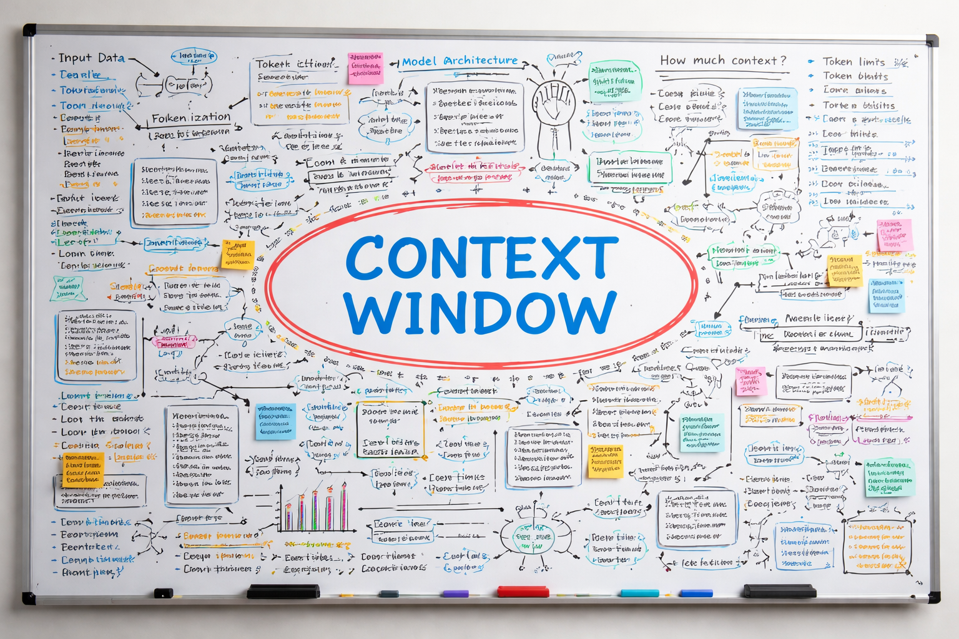
Context Window Analogy
The context window is like a whiteboard; Claude can only see what’s in it and nothing more. Every session, that whiteboard gets filled in layers. At the top are things Anthropic already wrote; Claude's built-in instructions & tools.
CLAUDE.md is the layer in your control. Every time Claude starts, it reads your file and knows your project. Below that is the conversation itself such as your messages, Claude's replies, any code it wrote, any files it opened. That part keeps growing the longer you work.
The context has a size limit. When it's full, Claude starts forgetting the top of the conversation. That's when you use /compact; it summarizes the history and frees up space, like erasing the old content while saving a summary.
© All rights reserved for Dr. Ryan Ahmed @Stemplicity Inc.

Slide 9
When the context Window fills up
The problem
The fix: /compact
Claude has a token limit
The longer you work, the more history fills up
When full, older messages get dropped
Claude loses early context; it may forget things you said
Run /compact in your session
Claude summarizes the conversation history
Summary replaces the full history which frees up space
CLAUDE.md always survives; it reloads fresh every time
© All rights reserved for Dr. Ryan Ahmed @Stemplicity Inc.
Key takeaway: CLAUDE.md is permanent. Conversation history is not.

Slide 10
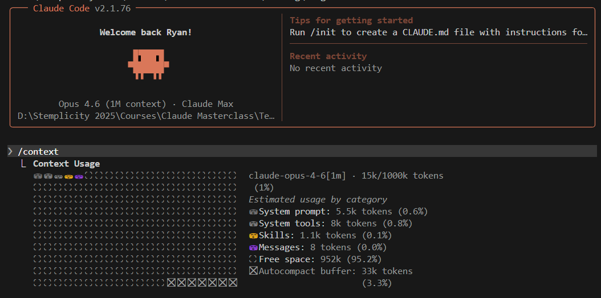
/context
Running /context in Claude Code shows a live breakdown of how your 1M token limit is being used, including the system prompt, tools, memory, and your conversation messages. At the start of a session, most of the window is still free (99% here).
The autocompact buffer (33k tokens, 3%) is space Claude reserves to summarize the conversation before the window fills up completely, so it can compact automatically without losing your work.
© All rights reserved for Dr. Ryan Ahmed @Stemplicity Inc.

Slide 11
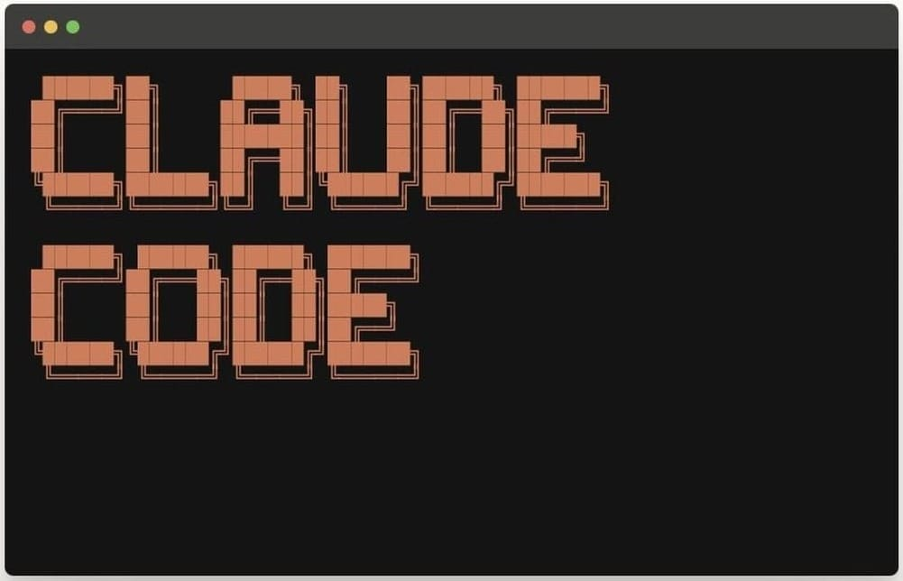
Context Window in Claude
Show /context command
© All rights reserved for Dr. Ryan Ahmed @Stemplicity Inc.

Slide 12
PROJECT: BUILD A CALORIE TRACKER WITH CLAUDE CODE (PHASE 1)

Slide 13
Project Overview
Phase 1
Phase 2
Phase 3
Build App
Scaffold the full calorie tracker
Add AI
Gemini-powered food search & photos
Improve with Ralph
Review, iterate, and polish
© All rights reserved for Dr. Ryan Ahmed @Stemplicity Inc.
You are here

Slide 14
Best Practice: Plan Mode
What is Plan Mode?
Without Plan Mode
Claude jumps straight into code
Might go in the wrong direction
Press Shift+Tab twice in Claude Code
Claude thinks and designs before writing code
You review the plan first, then approve it
Result: better architecture, fewer rewrites
With Plan Mode
Claude designs the architecture first
You review, then it builds right
© All rights reserved for Dr. Ryan Ahmed @Stemplicity Inc.
Shift + Tab → Plan Mode activated

Slide 15
Build a calorie tracker app – Phase 1
© All rights reserved for Dr. Ryan Ahmed @Stemplicity Inc.

Slide 16
Step 0: Setup Your Environment
What this prompt does:
Gemini API Key
Get your free key from aistudio.google.com
Node.js Check
Verify Node.js v18+ is installed
© All rights reserved for Dr. Ryan Ahmed @Stemplicity Inc.
Empty Folder
Create a clean project directory
.env & .gitignore
Store GEMINI_API_KEY placeholder, ignore secrets

Slide 17
Step 1: Plan & Build the Whole App
What this prompt does:
Uses Plan Mode to design the architecture
Scaffolds a full Next.js / TypeScript / Tailwind app
Creates a local SQLite food database
Builds search, daily log, calorie totals, common foods
Creates CLAUDE.md for project memory
Generates dated docs/ decision log
© All rights reserved for Dr. Ryan Ahmed @Stemplicity Inc.

Slide 18
PROJECT: BUILD A CALORIE TRACKER WITH CLAUDE CODE (PHASE 2)

Slide 19
Phase 2: What We’re Adding
Three ways to add food, all powered by AI
⌨ Type it
Text Search via AI
"grilled chicken with rice"
◎ Snap it
Photo Upload via AI
Upload a photo of your meal
☑ Quick-add
Tap Common Foods
Select from your frequent items
© All rights reserved for Dr. Ryan Ahmed @Stemplicity Inc.
Gemini AI analyzes → Nutrition data saved to database

Slide 20
Step 1: Build the API Routes
Two API routes, one AI model
Route 1: Text Query
User types: "grilled chicken with rice"
Gemini parses the text and returns structured nutrition JSON
Model: gemini-2.5-flash-lite
Route 2: Image Upload
User uploads a photo of their meal
Gemini analyzes the image and identifies each food item
Returns structured nutrition JSON per item
© All rights reserved for Dr. Ryan Ahmed @Stemplicity Inc.
Backend only — don’t touch the frontend yet

Slide 21
Step 2: Wire the Frontend
Connect AI to the UI
Quick-Add
Tap common foods from existing list; saves instantly
Text Search
Type any food → AI route → nutrition data → save
© All rights reserved for Dr. Ryan Ahmed @Stemplicity Inc.
Photo Upload
Snap a photo → preview image → AI identifies items → confirm & save
UX Details
Loading spinner • Error handling • Photo preview • Multi-item confirmation

Slide 22
Before and after testing
BEFORE
Pick from a list of 20 hardcoded foods
Limited options, no customization
Manual calorie entry for anything else
AFTER
Type anything OR snap a photo
AI identifies every food item automatically
Accurate nutrition data in seconds
© All rights reserved for Dr. Ryan Ahmed @Stemplicity Inc.
From a basic food picker to an AI-powered nutrition tracker

Slide 23
PROJECT: BUILD A CALORIE TRACKER WITH CLAUDE CODE (PHASE 3)

Slide 24
What is the Ralph Loop?
R
A
L
P
H
Review
Look at the current state
Assess
What works, what doesn’t
List
Potential improvements
Prioritize
Rank by impact vs effort
Handle
Implement the top ones
© All rights reserved for Dr. Ryan Ahmed @Stemplicity Inc.
It’s a plugin — install it and run /ralph-loop

Slide 25
The Quality Loop
Structured, verified improvement, not random changes
Ralph Reviews
Implements Improvements
Frontend-Design Verifies
Done!
Ship it
© All rights reserved for Dr. Ryan Ahmed @Stemplicity Inc.
↻ Repeat 2–3 times until professional quality
Not random changes; structured, verified improvement

Slide 26
Step 1: Install Tools
Two tools that work together:
Ralph Loop Plugin
claude plugin marketplace add anthropics/claude-code
claude plugin install ralph-wiggum
Runs structured improvement cycles (Review, Assess, List, Prioritize, Handle)
© All rights reserved for Dr. Ryan Ahmed @Stemplicity Inc.
Frontend Design Skill
npx skills add https://github.com/anthropics/skills --skill frontend-design
Gives Claude the eye of a professional UI designer — verifies quality after each round
Run these in your terminal not inside Claude Code

Slide 27
Step 2: Run Ralph & Polish
Features being added:
The quality bar:
Calorie Goal
Visual progress bar (green/yellow/red)
Looks like a real product; not a tutorial demo
Clean layout, consistent spacing, professional colors
Intuitive UX; a first-time user knows what to do
Works on both desktop and mobile
Has loading states, empty states, error messages
Macros
Protein, carbs, fat breakdown with chart
Meal Categories
Breakfast, Lunch, Dinner, Snack groups
Header
App name + today’s date
Card Layout
Card-style food entries
© All rights reserved for Dr. Ryan Ahmed @Stemplicity Inc.

Slide 28
Before & After
Before Ralph
• Basic food log
• Plain list display
• Hardcoded styling
• No calorie goals
• No macro tracking
• No meal categories
• Desktop-only layout
After Ralph
✓ Calorie goals with progress bar
✓ Macro charts (protein/carbs/fat)
✓ Meal categories (grouped entries)
✓ Card-style food entries
✓ Professional design & colors
✓ Responsive (desktop + mobile)
✓ Loading/empty/error states
© All rights reserved for Dr. Ryan Ahmed @Stemplicity Inc.
From functional to professional in one prompt

Slide 29
Thank you!

